Slide 1
Diabetes Prediction using Machine Learning Team Members
Chaitra Tadaga prabhukumara Onyinyechi Nwadiuto Agu
Course: DSCI 6612
Date: 6th December, 2021

Slide 2
Table of Contents
Overview of the project
Datasets and Variables
Machine Learning Model and Results
Evaluation Method
Conclusion
Links and references

Slide 3
Overview of the project
Diabetes mellitus, commonly known as diabetes, is a metabolic disease that causes high blood sugar.
According to 2017 statistics, 425 million people suffered from diabetes.
The World Health Organization predicts that by 2030, diabetes will become the seventh leading cause of death in the world. There are few different types of diabetes:
- Type 1 diabetes is an autoimmune disease. The immune system attacks and destroys cells in the pancreas, where insulin is made. It’s unclear what causes this attack. About 10 percent of people with diabetes have this type.
- Type 2 diabetes occurs when your body becomes resistant to insulin, and sugar builds up in your blood.
- Prediabetes occurs when your blood sugar is higher than normal, but it’s not high enough for a diagnosis of type 2 diabetes.
- Gestational diabetes is high blood sugar during pregnancy. Insulin-blocking hormones produced by the placenta cause this type of diabetes.
We have proposed a diabetes prediction model for better classification of diabetes which includes few external factors responsible for diabetes along with regular factors like Glucose, BMI, Age, Insulin, etc.

Slide 4
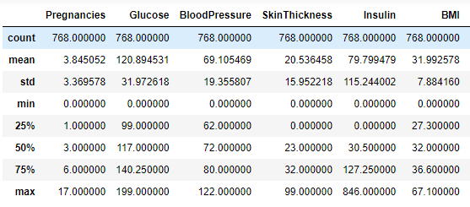
Dataset
The dataset has 9 features
769 observations
Correlation for independent variables(feature column)
The dataset as divided into test and train data

Slide 5
Diabetes Prediction Model
Features: Pregnancies, Glucose, Blood Pressure, BMI , Insulin level, Age , Outcome
Train the Machine Learning model
Once the model is built and it is good, we can use it to predict the test data.
Preprocess Data
Build model
Dataset
Training Data
Testing Data
Evaluation

Slide 6
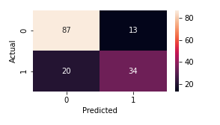
Machine Learning Models: Logistic Regression
The model gave an accuracy of 0.78. The confusion matrix showed that 87 patients were diagnosed as not having diabetes and 34 patients are correctly predicted as having diabetes.

Slide 7
Machine Learning Models: K-Nearest Neighbour(KNN)
The accuracy of KNN was 0.71.To improve the accuracy of the model, hyperparameters using Grid search was turned.
The n-neighbors = 13 and the leaf = 1. The accuracy of the KNN model increased to 0.75

Slide 8
Machine Learning Models: Support vector Machine (SVM)
For this classifier,0.75 accuracy was achieved. Evaluation was done using confusion matrix and it predicted that 11 healthy patients have diabetes.
The hyperparameters c and gamma were tuned and features were scaled. The improved model showed accuracy to 0.79.
89 | 11
27 | 27
89 | 11
21 | 33

Slide 9
Machine Learning Models: Decision Tree
The accuracy of the Decision tree gave an accuracy of 0.68.
Altering hyper parameters using Grid Search in Scikit-Learn.
Optimized max _depth = 7
min_samples_leaf = 8
Result : It had test data accuracy of 0.75 and it was evaluated using confusion matrix. It correctly predicted that 37 patients are diagnosed with diabetes.

Slide 10
Machine Learning Models: Random Forest Tree
Random forest model gave an accuracy of 0.79.
Altering hyper parameters using Grid Search in Scikit-Learn caused the model to have a slight improvement in accuracy with a FN 14 and FP 17.

Slide 11
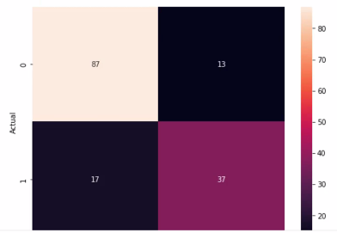
Machine Learning Models: XGBoost
XGBoost(Extreme Gradient Boosting) which is an ensemble method gave an accuracy of 0.80 which is better than all the models we have built thus far. The evaluation also showed a TP 87 and TN 37.

Slide 12
Machine Learning Models: Light GBM
Light GBM(LGBM) is a fast, distributed, high performing gradient boosting framework which is based on decision tree, used for classification and other machine learning tasks.
The accuracy of the model was 0.78.

Slide 13
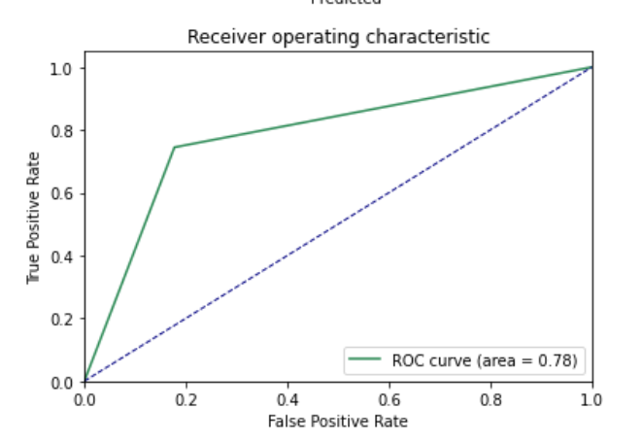
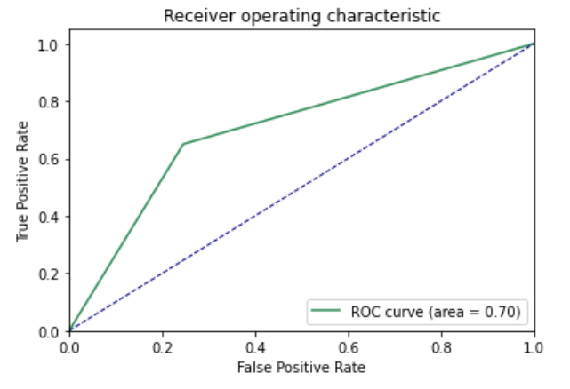
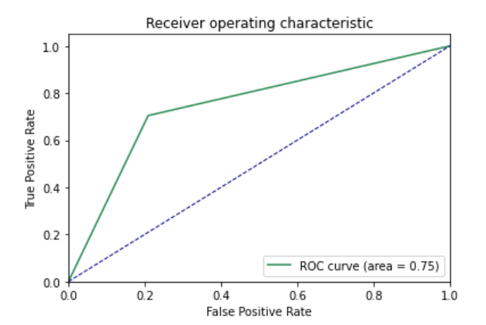
Evaluation methodology
ROC curve
Logistic regression
KNeighbors
Support vector matrix

Slide 14
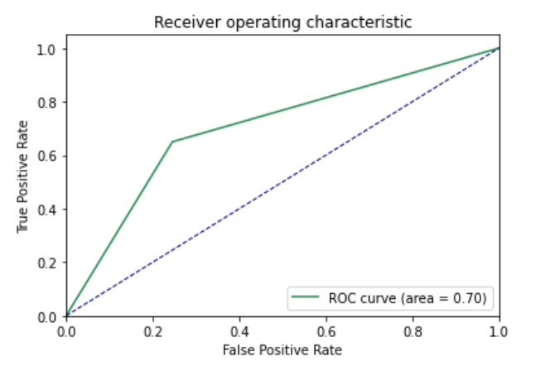
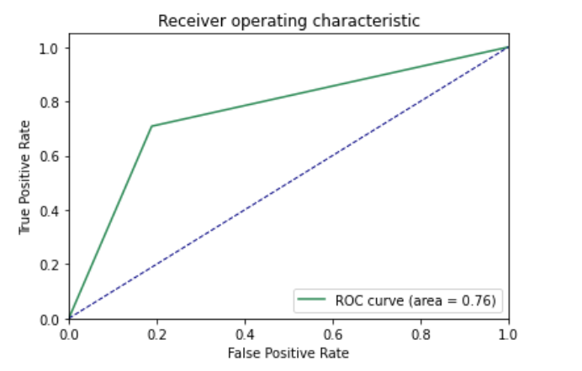
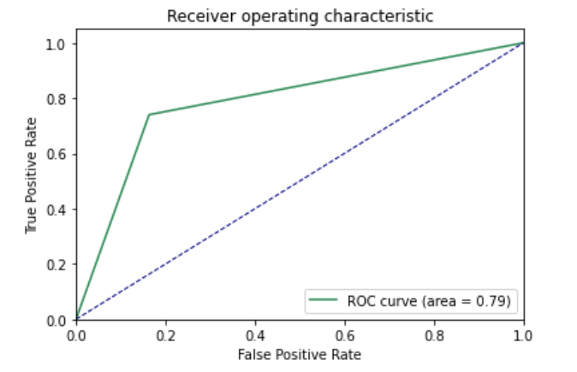
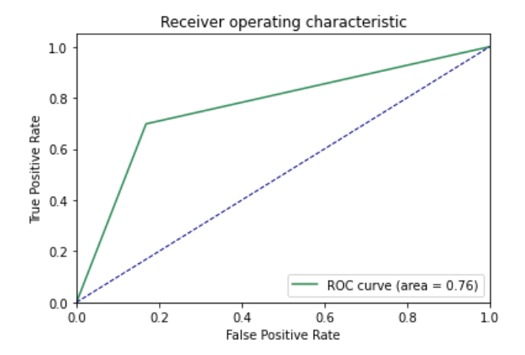
Evaluation methodology
Decision classifier
Random forest classifier
XGBoost
Light GBM

Slide 15
Conclusion

Slide 16
Comparison of 7 models
 | LR | KNN | SVM | Decision classifier | Random forest | XGB | LGBM
Accuracy | 0.798 | 0.777 | 0.792 | 0.753 | 0.779 | 0.805 | 0.785
Precision | 0.744 | 0.65 | 0.792 | 0.637 | 0.708 | 0.730 | 0.785
Recall | 0.648 | 0.481 | 0.629 | 0.685 | 0.629 | 0.703 | 0.685

Slide 17
References
https://www.sciencedirect.com/science/article/pii/S1877050920300557
https://www.kaggle.com/ilkeryildiz/diabetes-prediction-using-machine-learning/notebook
https://github.com/npradaschnor/Pima-Indians-Diabetes-Dataset/blob/master/Pima%20Indians%20Diabetes%20Dataset.ipynb
https://www.analyticsvidhya.com/blog/2021/06/tune-hyperparameters-with-gridsearchcv/
Thank You

